Slide 1

NUMONI BRIEFING
ACACIA – Android & iOS
19 September 2016

Slide 2
Agenda
Introduction to Cordova
Frameworks 101
Tools Used
Android & iOS differences
Project Status
Future Enhancements
Additional Links

Slide 3
Introduction to Cordova

Slide 4
Introduction
Hybrid App Development
Platforms
  Cordova
    PhoneGap
Mobile Frameworks
  ionic (UI, JS)
  onsenui (UI) → Chosen UI Framework
  AngularJS (JS) → Chosen JS Framework
  jQuery (Library) → Chosen Networking/JS Framework
  jquery mobile (UI, Client)
Notes:
https://forum.ionicframework.com/t/pros-cons-vs-onsen-ui/8177
Thanks for honest opinion. Personally I do not see myself as the target audience for a WYSIWYG editor -- mainly because of the terrible code those types of editors tend to output (though I see clean code is touted as one of the features). But I understand your overall point in regards to surrounding services that can enhance a developers workflow. To that end, I believe: http://monaca.mobi/en/190 is Onsen's "answer" to Ionics surrounding services, but I may be wrong about that.
My 3 biggest concerns when comparing Onsen and Ionic are:
http://components.onsenui.io/628 - The ability to theme my app like this, so easily, is a HUGE draw for someone like me who is "challenged" in the way of design.
This one post reference Onsen as having better list performance out of the box than Ionic:http://forum.ionicframework.com/t/ionic-list-performance/546/11
Ionic is in beta, while Onsen apparently is not. Though this is definitely not the biggest deal in the world for me.
My largest draws to Ionic when compared against Onsen are:
Community. Onsen defers support to Stack Overflow
Ionic's Showcase. Proves to me there are production apps using Ionic in successful ways
Ionic's Activity. Onsen seems to have 1 primary programmer on GitHub, while it seems Ionic has 3-4.
I'm posting all this here just as a reference for others, or to be proven wrong on any of these points. Currently I am leaning in favor with Ionic because I feel that it's likely only a matter of time before this team closes the gap on any of the concerns I listed above.
Thanks again
One year has passed since both frameworks are available on the market. Onsen UI is currently in stable 1.2 version while Ionic is in the last release candidate state.
I have worked with both of them so let me give you a short overview, I also wrote a much larger blog article, you'll find it at the end of this answer.
I won't go into much details about the core framework; if you have a previous AngularJS knowledge you will easily transition to Ionic or Onsen UI.
Both frameworks are built around AngularJS and they heavily depend on directives, you can also easily build your own custom directives. Onsen UI also features a jQuery support (unnecessary if you ask me).
Both frameworks support Android 4+, iOS 6+ (some features are available on Android 2.3), Onsen UI also officially supports Firefox OS and desktop browsers. Ionic don't have an official desktop support, but it will still work (it will not be pretty, imagine ).
Ionic currently don't support Windows Mobile platform (it will have it in the future), Onsen UI support is currently in development (since November 2014).
Both frameworks support some kind of splitview feature so they can be used for table development.
Both frameworks have a distinctive nice looking flat UI. I prefer Ionic over Onsen UI look and feel, but this is a matter of personal taste. Both default themes look iOS 7 like.
Onsen UI supports native looking themes for Android and iOS. Ionic framework uses the same theme for all platforms, but some features will depend on the platform (for example tab look and feel)
Both frameworks have a working theme builder.
Ionic supports SASS while Onsen UI is built around Topcoat CSS library.
Both frameworks have a large widget support (directives)
Onsen UI has a better documentation. It is separated at two different locations. First one is “Components” where you can see different directives and each one has a working example you can use and replicate. Second part is a “Guide” where you are guided through the application creation process.
Ionic has a disorganized documentation (heavily fragmented). It lacks a real “getting started” tutorial, even if you have previous AngularJS experience. It shows you pieces, but not how to connect them correctly.
On the other hand Ionic has much larger community so you will easily find problem solutions.
Ionic framework has a great official forum + large StackOverflow community. At the same time, Onsen UI uses only StackOverflow as a help center (I would call this a fail).
Onsen UI has an HTML5 IDE called MONACA IDE (great tool), Ionic IDE is currently in production, you can participate in beta test.
Ionic has a growing 3rd party plugin community (for example date picker), I couldn't find any 3rd party Onsen UI plugin

Slide 5
Folder structure of Cordova Projects
www
  config.xml
  index.html
platforms
  android
  ios
plugins
hooks
merges
custom_plugin

Slide 6
Initialisation Sequence
Click On App in App List
Launch App WebView
Webview Loads Splash Screen
Load index.html
  Javascript Libraries
  CSS Libraries
Load OnsenUI
Load Home Screen/Login & Signup Page

Slide 7
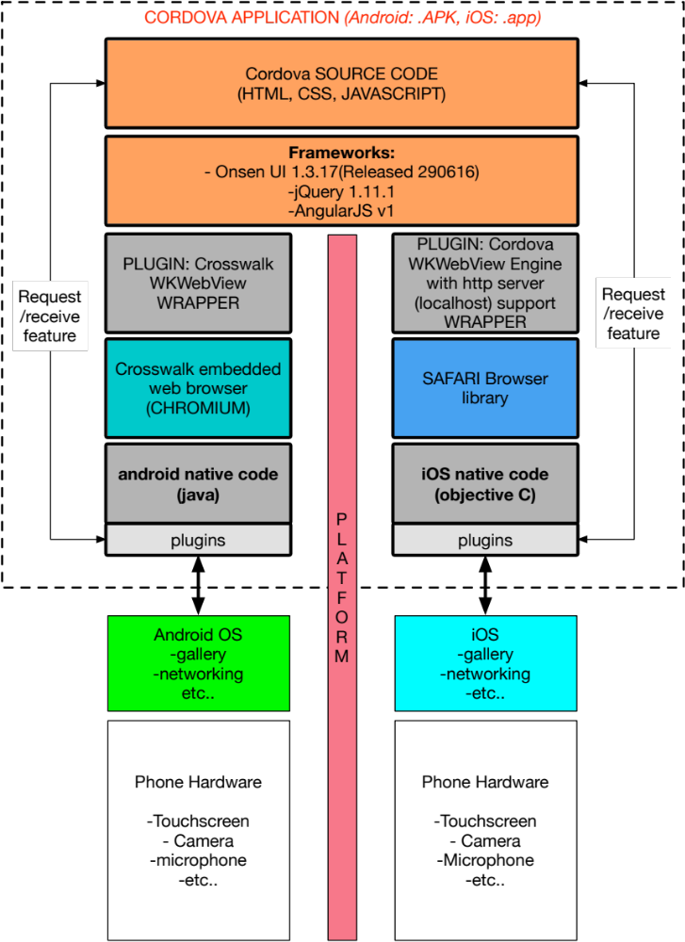
Acacia: Layers of Application

Slide 8
Frameworks 101
Onsen UI Framework + AngularJS

Slide 9
OnsenUI
UI Framework
  Excellent Documentation
  V1 Released, V2 in Beta during development of Acacia
Compatible Javascript Frameworks
  AngularJS
  Angular 2
  React
  Vue.js
  Meteor

Slide 10
OnsenUI – Key Components Used
ons-sliding-menu
ons-list
  lazy-repeat
  ng-repeat
ons-dialog
ons-alert-dialog

Slide 11
AngularJS
Follows MVC Principle
  Controllers
  Services
  Directives
Extend HTML
High lvl of Abstraction

Slide 12
AngularJS - Controllers
1 Core App Object → Declare Controller
  Onsen Bootstrap
Load HTML Page → Load Controller (ng-controller)
Each controller
  1 HTML file
  Sequence of files (ons-navigator)

Slide 13
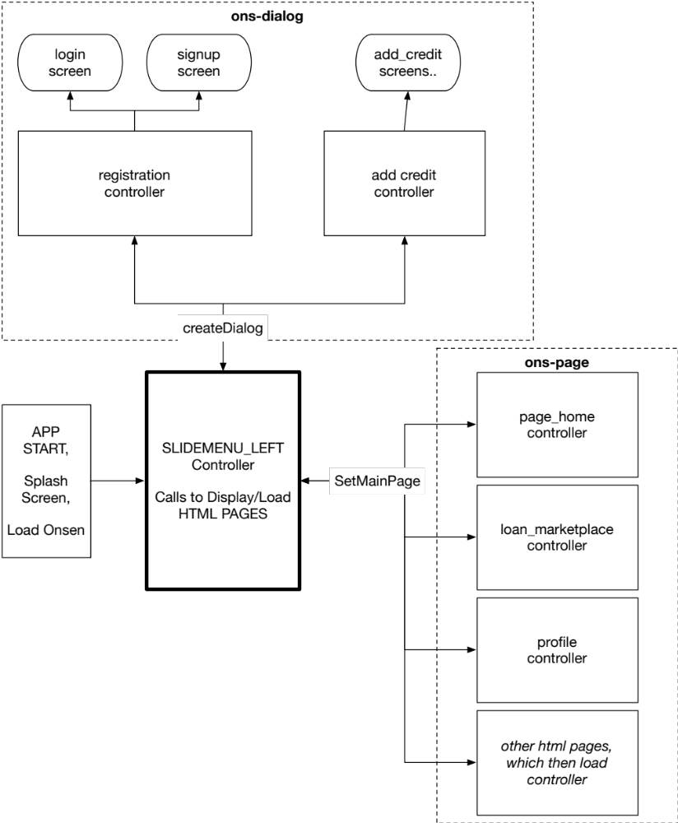
Acacia Controllers – General Flow

Slide 14
Services
persistence through app lifecycle
dependency injection for controller
Acacia
  Networking
  User Credentials
  Alerts
  Persistent Database

Slide 15
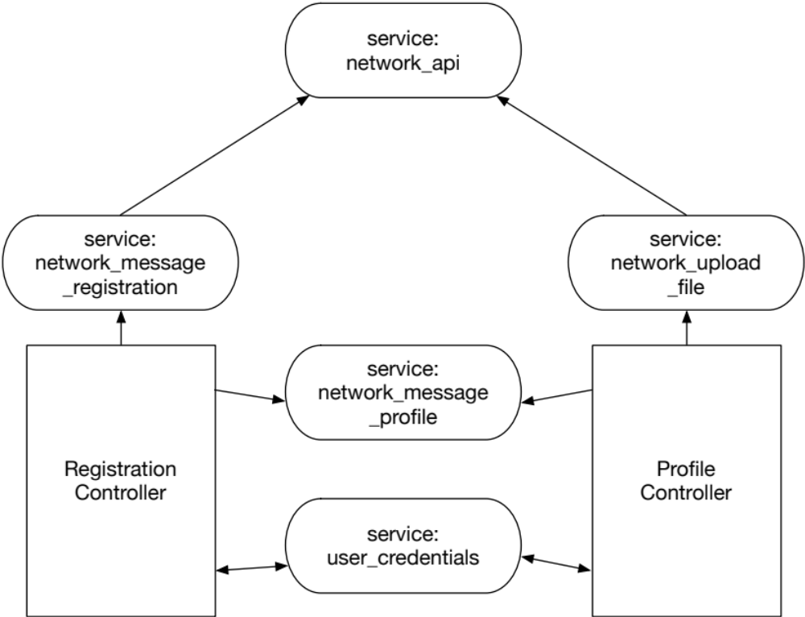
Controller & Services Relationship:
Example

Slide 16
Tools Used

Slide 17
Software
IDE → Intellij IDEA
browser → Google Chrome
Code versioning → SVN
App templating → monaca
Package management → npm (node.js)

Slide 18
Command Line
npm
bower
cordova
monaca
plugman
browserify (requirejs modules)

Slide 19
Plugins
android_quit (custom plugin)
cordova-plugin-camera
cordova-plugin-datepicker
cordova-labs-wkwebview-engine-localhost(iOS)
cordova-plugin-crosswalk-webview(Android)

Slide 20
Libraries
LokiJS
  Databases For Persistent DATA
rateYo
intl-tel-input
countrySelect, citySelect
intl
owl-carousel

Slide 21
Android & iOS Differences

Slide 22
Android
Freely deploy apks
Code Obfuscation needed
  Security
Easier to edit project configs
Debug: chrome://inspect

Slide 23
iOS
Xcode
Deployment of applications
Team provisioning, licensing
Mac Only
Debug: Safari→Develop→iPhone→index.html

Slide 24
Project Status

Slide 25
Task Completion
All tasks completed as of these documents:
  NuMy_DEV_ACACIA_Sequence Diagram_v1.4_20160711-YC.xlsx
  NUMy_DEV_NuAcacia Features_v1_20160609_YC v1.5.xlsx
Outstanding Modules, required for Launch
  Transaction History
  Loan Portfolio
  Payment Gateway
  Code Obfuscation

Slide 26
Future Enhancements

Slide 27
Onsenui 2.0
Released on 15 September 2016
Onsen UI 2.0 remains framework agnostic in core and bindings, and is entirely independent of any JavaScript framework trend.
supports Angular 1 & 2, React, jQuery, Meteor and Vue.js
enables both flat (iOS) and Material Design (Android) with automatic styling depending on the running platform
Meet Onsen UI Toolkit with Monaca CLI. Start your apps from prepared templates and debug in real devices

Slide 28
Additional Links

Slide 29
Mobile Framework Comparison
http://www.devx.com/wireless/pros-and-cons-of-5-mobile-ui-frameworks.html
http://www.letscodejavascript.com/v3/blog/2015/01/angular_review
http://stackoverflow.com/questions/21859054/onsenui-vs-ionic-framework
https://www.quora.com/Whats-the-best-UI-framework-of-Onsen-UI-or-Ionic
http://www.gajotres.net/best-html5-mobile-app-frameworks-onsen-ui/

Slide 30
Solutions to Problems
http://stackoverflow.com/questions/9600382/svn-command-to-delete-all-locally-missing-files
http://stackoverflow.com/questions/37172346/lokijs-loses-db-and-data-in-collection-when-i-try-to-add-more-data-after-colesin
http://stackoverflow.com/questions/28575999/input-field-hidden-when-soft-keyboard-appears-in-phonegap
http://stackoverflow.com/questions/13796234/window-scrollto-not-working-in-phonegap-alternative-solution-or-workaround/13808307#13808307
http://stackoverflow.com/questions/469357/html-text-input-allow-only-numeric-input
http://stackoverflow.com/questions/33792527/cordova-crosswalk-ios-still-using-uiwebview

Slide 31
Bugs
https://github.com/katzer/cordova-plugin-local-notifications/issues/682
https://github.com/Telerik-Verified-Plugins/WKWebView/issues/209
https://github.com/Telerik-Verified-Plugins/WKWebView/issues/121

Slide 32
Tutorials
http://www.mat-d.com/site/tutorial-creating-a-cordova-phonegap-plugin-for-android-app/
http://stackoverflow.com/questions/28843883/append-image-file-to-form-data-cordova-angular
http://zhangwenli.com/blog/2014/08/25/crosswalk-calling-java-methods-with-javascript/

Slide 33
Libraries/Plugins
https://github.com/sanctus671/cordova-plugin-local-notifications-pgb
http://www.localeplanet.com/api/auto/currencymap.json
https://github.com/mrmarkfrench/country-select-js
http://rateyo.fundoocode.ninja/
https://crosswalk-project.org/documentation/about/faq.html
https://github.com/ftlabs/fastclick
https://github.com/kerrishotts/cordova-keyboard-example
http://jsbin.com/qakiwebapo/edit?html,css,js,output

Slide 34
Optimization
http://www.learningjquery.com/2010/05/now-you-see-me-showhide-performance
http://blog.christoffer.me/six-things-i-learnt-about-ios-safaris-rubber-band-scrolling/

Slide 35
Programming Reference
https://msdn.microsoft.com/en-us/library/dn324922(v=vs.94).aspx
https://xd.adobe.com/view/20768e1e-9fc7-4c66-6166-a0c07fec5e85/

Slide 36
Platform Introduction
https://www.visualstudio.com/en-us/features/mobile-app-development-vs.aspx
https://developer.xamarin.com/guides/ios/getting_started/installation/windows/introduction_to_xamarin_ios_for_visual_studio/
https://developer.xamarin.com/guides/cross-platform/windows/ios-simulator/

